Slide 1
SMART LAMP
Controlled via wi-fi with proximity sensor and color light change
Group 18

Slide 2


WHAT IS A SMART LAMP?
IT’S A LAMP CONTROLLABLE BY AN APP, SO THE USER IS ABLE TO CONTROL IT ,
ALSO IF HE ISN’ T NEAR THE LAMP.

Slide 3
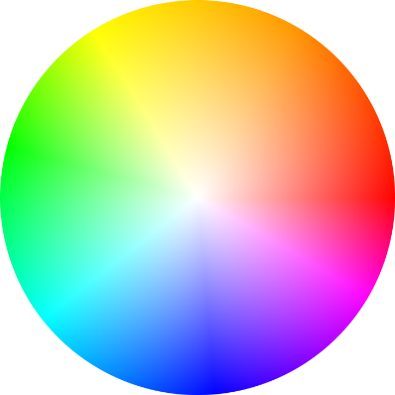





YOU CAN MODIFY AT YOUR PLEASURE THE COLOR AND THE BRIGHTNESS
IT IS EQUIPPED WITH VARIOUS MODES OF OPERATION TO ENSURE GREATER COMFORT TO THE USER.

Slide 4
COMPONENTS USED TO BUILT THE SMART LAMP
ESP 32 DEVKIT C BOARD
STRIP LEDS WS2812B
VCNL4010 PROXIMITY/LIGHT SENSOR
330 OHM RESISTOR
BREADBOARD

Slide 5
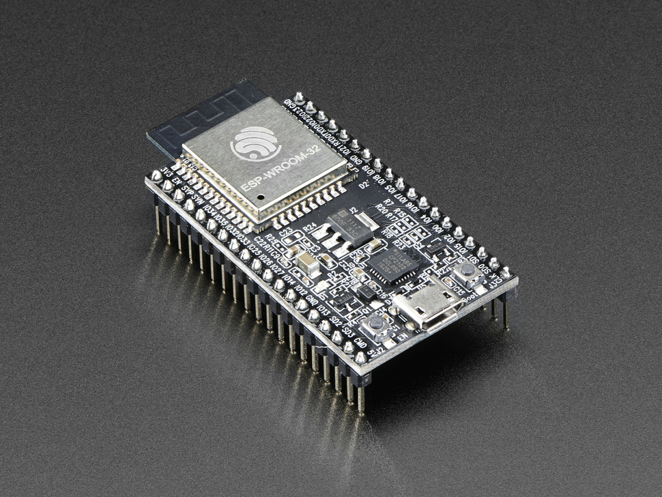
ESP 32 DEVKIT C BOARD
IT IS A DEVELOPMENT BOARD BASED ON THE ESP-WROOM-32 MICROCONTROLLER UNIT (MCU)
INCLUDES MICRO-USB INTERFACE FOR PROGRAMMING
POWERED BY USB OR BY 5V OR 3.3V PINS
INCLUDES WIFI AND BLUETOOTH LOW ENERGY (BLE)
SEVERAL PROGRAMMABLE GENERAL-PURPOSE I/O PINS (GPIO) FOR THE APPLICATON

Slide 6
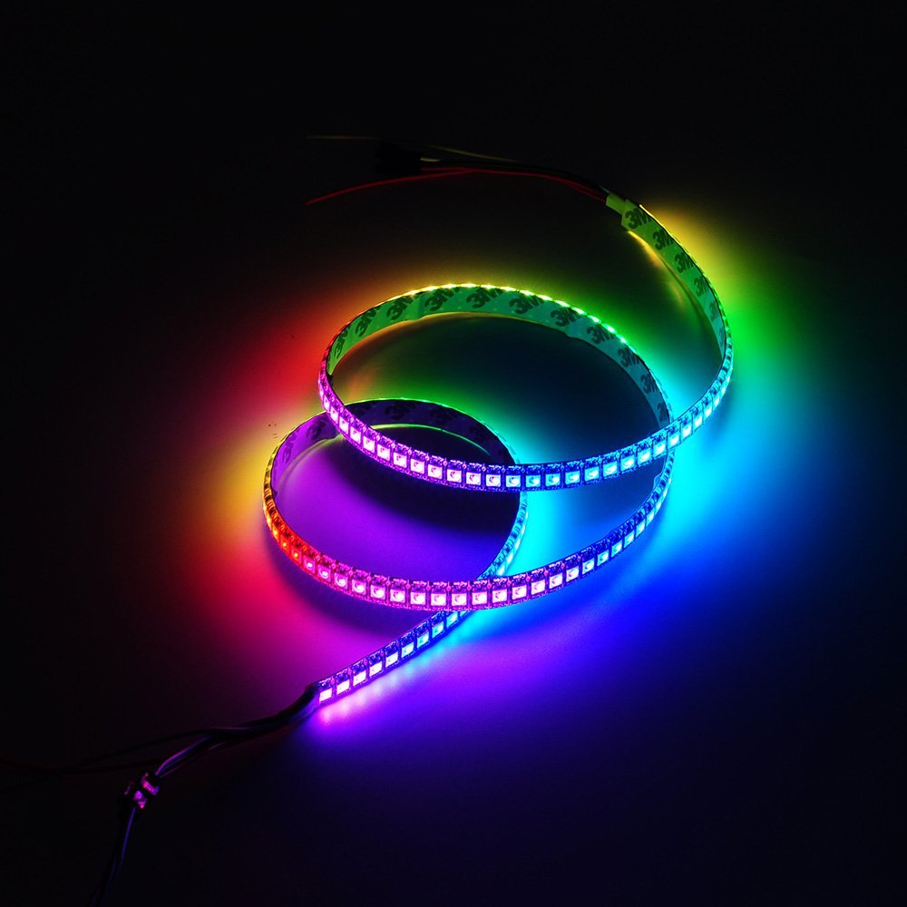
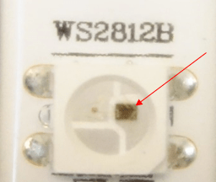
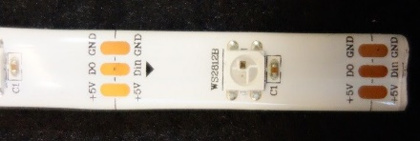
STRIP LEDS WS2812B
IT IS AN ADDRESSABLE RGB LED STRIP
256 LIGHT TONES AND 24-BIT COLOR DISPLAY.
YOU CAN CONTROL THE BRIGHTNESS AND THE COLOR OF EACH LED INDIVIDUALLY, WHICH ALLOWS TO PRODUCE AMAZING AND COMPLEX EFFECTS IN A SIMPLE WAY.
THE WS2812B LEDS ARE WIRED IN SERIES. THESE LEDS HAVE A IC BUILT RIGHT INTO THE LED. THIS ALLOWS A COMMUNICATION VIA A ONE-WIRE INTERFACE. THIS MEANS THAT IT CAN CONTROL LOTS OF LEDS USING JUST ONE DIGITAL PIN.

Slide 7
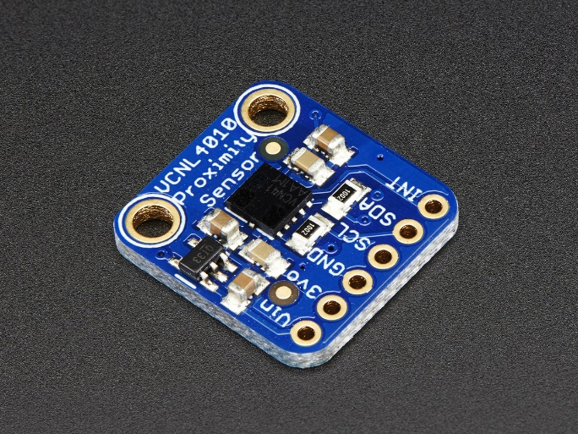
VCNL4010 PROXIMITY/LIGHT SENSOR
THE VCNL4010 IT IS A FULLY INTEGRATED PROXIMITY AND AMBIENT LIGHT SENSOR
IT USES I2C PROTOCOL TO INTERFACE WITH MICROCONTROLLER
THE SENSOR RETRIVES AMBIENT LIGHT AND PROXIMITY ON DEMAIND BECAUSE WE DON'T NEED THESE DATAS ALL THE TIME

Slide 8
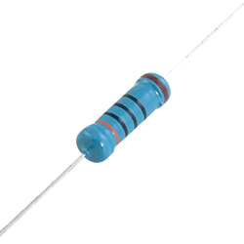
HOW THEY ARE CONNECTED
THE SENSOR AND THE STRIP LEDS ARE BOTH CONNECTED WITH THE MCU USING THE BREADBOARD.
LED STRIP (3 PIN):
VIN/GND: CONNECTED TO MCU 5V AND GND PIN
DIN : IN THIS PIN ARE SENT DATA USED TO CONTROL THE LED. IT IS CONNECTED
TO PIN D26 OF MCU SETTED AS A DIGITAL OUTPUT
IT’ BEEN USED A 330 OHM RESISTANCE TO LIMIT THE CURRENT THAT GET OUT FROM THE DIGITAL OUTPUT PIN

Slide 9
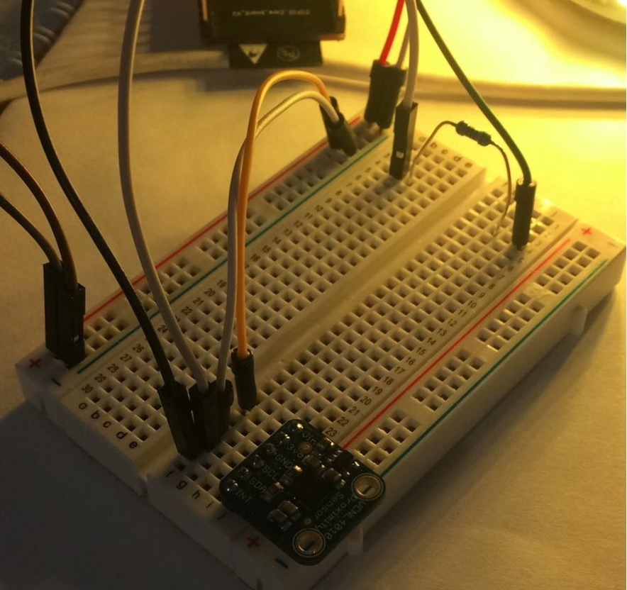
PROXIMITY/LIGHT SENSOR:
VIN/GND: CONNECTED TO MCU 5V AND GND PIN
THIS SENSOR IS 5 VOLT COMPLIANT SO YOU CAN USE IT WITH 3.3V OR 5V LOGIC WITH NO RISK OF DAMAGE.
IT HAS BEEN CHOSEN TO ALIMENT IT WITH 5V IN, SINCE THE HIGHER THE VOLTAGE YOU CAN GIVE IT, THE MORE POWERFUL IT IS.
SCL/SDA: CONNECTED TO PIN D17/D16

Slide 10
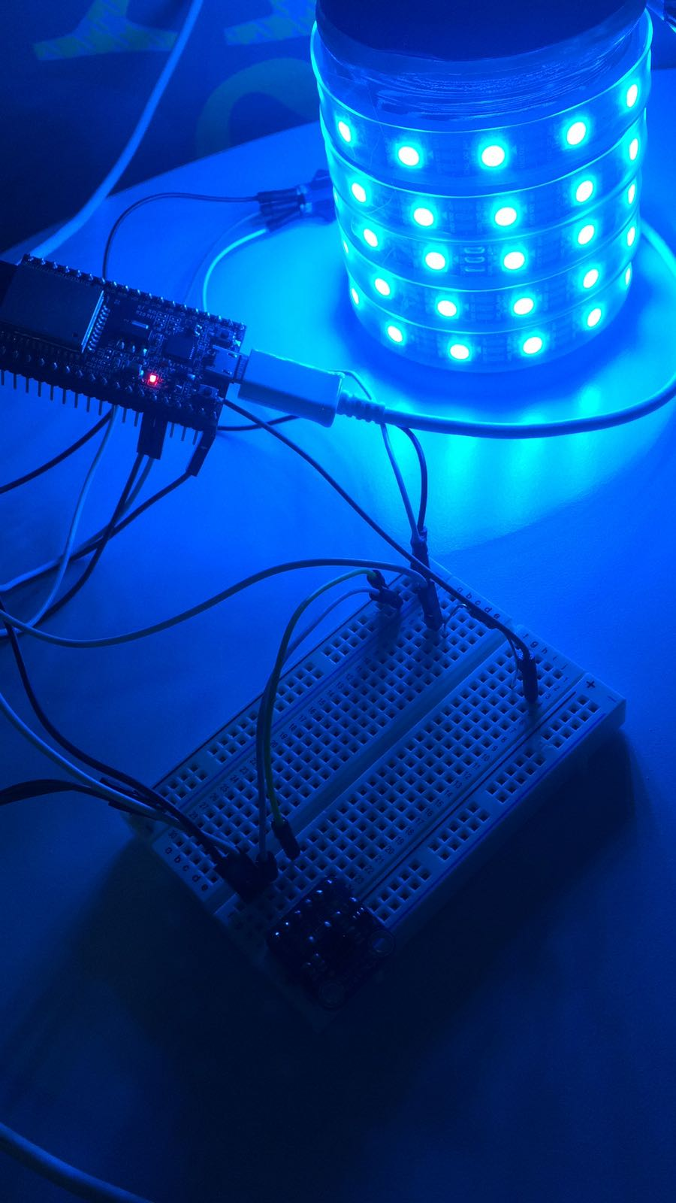
HOW THE SMART LAMP APPEARS

Slide 11
ON THE OTHER SIDE….
THE USER CAN CONTROL THE LAMP USING AN APP
IT’ S BEEN CHOOSEN THE ZERYNTH FRAMEWORK APP BECAUSE IT IS A FREE APP AND TO ACCESS THE USER ONLY NEEDS ZERYNTH CREDENZIALS.
DATA ARE SENT AND RECEIVED BETWEEN THE APP AND THE MCU BY USING ZERYNTH SERVERS.
THE APP HAS BEEN CUSTOMIZED USING HTML, CSS AND JAVASCRIPT.

Slide 12
TEMPLATE
THE APP IS COMPOSED BY THESE ELEMENTS:
INDEX.HTML : IS THE PAGE SHOWED ON THE BROWSER
SCRIPT.JS : A JAVASCRIPT FILE CONTAINIG FUNCTION TO SENT AND RECEIVE DATA WITH THE DEVICE
FARBTASTIC.JS : A JAVASCRIPT FILE CONTAINIG FUNCTION TO GENERETE THE COLOR PICKER
SOME IMAGES USED AS BUTTONS

Slide 13
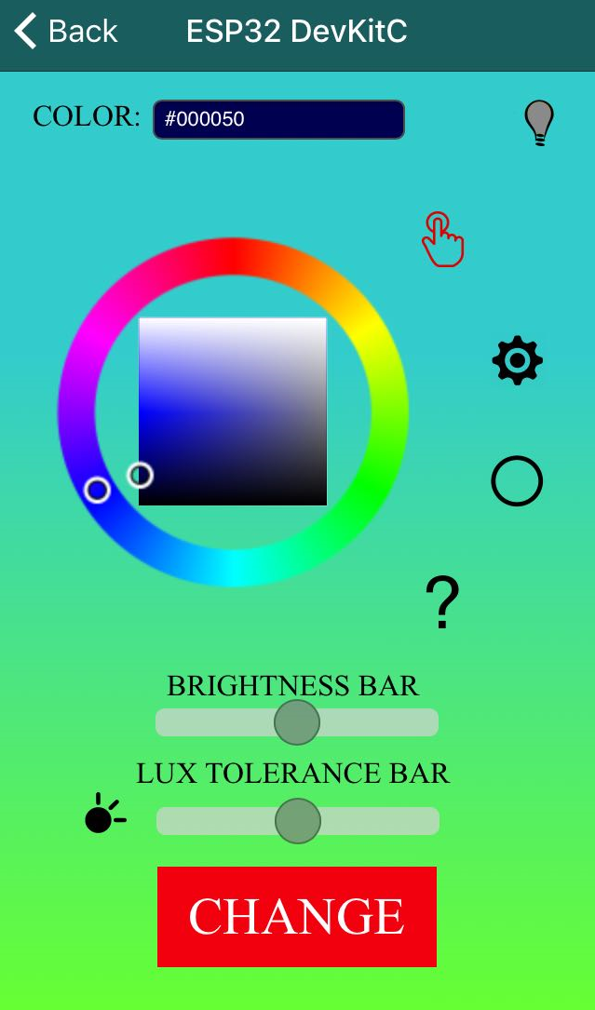
APP
THIS IS HOW APPEARS THE APP ON THE SMARTPHONE.
COMPONENTS:
COLOR BAR
BULB ICON
COLOR PICKER
FUNCTION MODE
BRIGHTNESS BAR
LUX TOLERANCE BAR

Slide 14

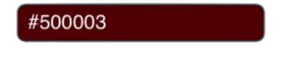

COLOR PICKER
THE COLOR PICKER IS A SELECTOR. IT IS USED BY THE USER TO SELECT THE NEXT COLOR THAT THE LAMP WILL DISPLAY.
COLOR BAR
IN THE COLOR BAR WILL BE DISPLAYED THE COLOR SELECTED IN THE COLOR PICKER.
THAT VALUE WILL BE SENT TO THE DEVICE WHEN THE USER WILL PRESS THE BUTTON «CHANGE»
BULB ICON:
IT IS AN ICON THAT REPRESENTS IF THE LAMP IS TURNED ON/OFF.
IF IT IS PRESSED IN «MANUAL MODE» IT WILL TURN ON/OFF THE LAMP.

Slide 15

BRIGHTNESS BAR:
IN THIS BAR THE USER CAN SELECT THE BRIGHTNESS LEVEL.
IT’ DEFAULT VALUE IS 50% OF LUMINOSITY
LUX TOLERANCE BAR:
IN THIS BAR THE USER CAN SELECT HOW MUCH DARKNESS IS NEEDED TO ALLOWS THE
DEVICE TO SET ON THE LIGHT IF AN OBJECT IS NEAR

Slide 16


FUNCTION MODE:
MANUAL MODE:
THIS IS THE DEFAULT MODE SET IN THE APP. IN THIS MODE THE
USER CAN TURN ON/OFF THE LAMP BY CLICKING ON THE BULB ICON
AND AFTER HE HAS SELECTED THE COLOR OR THE BRIGHTNESS, HE
CAN SET THE SMART LAMP CLICKING ON THE BUTTON «CHANGE»
AUTOMATIC MODE:
IN THIS MODE THE LAMP WILL TURN ON ONLY IF THE USER WILL
MOVE NEAR THE LAMP (IN A MAX RANGE OF 20 CM) AND THERE
IS LOW LIGHT IN THE ROOM. IN THIS MODE THE USER CANNOT TURN
ON/OFF THE LAMP

Slide 17


COLORCYCLE MODE:
IN THIS MODE THE LAMP WILL SHOW A CYCLE OF COLOR .
THIS MODE WAS DESIGNED TO RELAX THE USER.
HELP BUTTON:
AFTER PRESSED THIS BUTTON, THE APP WILL OPEN A NEW WINDOW WITH AN USER GUIDE INTO IT

